Slide 1
Adding mirror clauses within the European Green Deal: Hype or hope?
Alexandre Gohin*, Alan Matthews**
*UMR SMART INRAE Institut Agro, Rennes
**Trinity College Dublin
Corresponding author: Alexandre.Gohin@inrae.fr

Slide 2
1. Context
The European institutions adopted in 2020 the « Green Deal », with different objectives:
  Carbon neutrality,
  Reduced chemical input use in farming sectors,
  Increased area devoted to biodiversity, organic farming
Already many qualitative and quantitative analyses, consensus on some effects (Wesseler, 2022, Gohin, 2022):
  EU production will decrease, compensated by higher EU net imports
  World prices will increase
Other effects are disputed, such as:
  Environmental leakages in foreign countries where production may expand
  Evolution of the farm income (depending on price vs quantity effects)

Slide 3
1. Context
These quantitative analyses confirm one big concern immediately raised by many stakeholders/analysts on the trade dimensions of the GD. For instance,
  Copa Cogeca (2021): « European agriculture has sufficient resilience to adapt to the Green Deal if this policy does not act as a mechanism for environmental dumping »
  Guyomard et al. (2020): «The absence of the effective translation of EC intentions related to any border mechanism into concrete instruments can be viewed as the “Achilles heel” of the Green Deal initiative»
The idea of implementing « mirror clauses » quickly emerge (for instance, Baldon et al., 2021).
  Definition from Lamy et al. (2022): « The principal aim of mirror measures is to make market access conditional to compliance with domestic environmental, animal welfare or health standards and regulations. … Mirror measures call either for new provisions in bilateral free trade agreements or for measured imposed unilaterally through EU domestic laws. »

Slide 4
1. Context
Challenges with mirror measures:
  Lamy et al. (2022): « It is more difficult to justify (mirror) measures with external effects when they concern animal welfare or environmental protection »
  Matthews (2022): «The EU should carefully assess the benefits and risks of mirror clauses on an individual basis based on the six principles and following a full impact assessment ».
  European Commission (2022): « There is some scope to extend to imported productions EU production standards provided this is one in full respect of the relevant WTO rules…. Before applying production standards to imports, it is always essential to make a case by case assessment.»
So mirror clauses: hype or hope ? Let’s turn to lessons from economic analyses

Slide 5
2. Review of the economic literature
Mirror clauses are one of the many Non Tariff Measures (NTM) already extensively analysed (Beghin et Schweizer, 2021)
To our knowledge, many ex post analyses compared to ex ante assessments (in particular using « gravity econometrics »)
theory explained in Matthews (2022) in a simple but robust setting
One empirical analysis by Beckman (2022) with GTAP

Slide 6
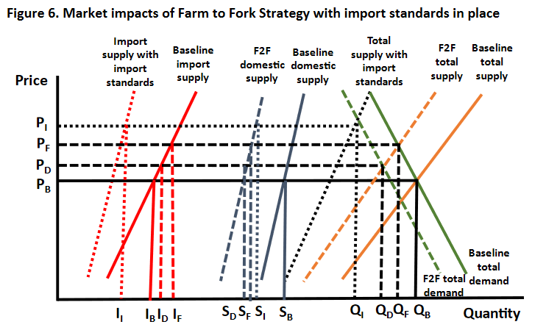

Slide 7
2. Review of the economic literature
Beckman et al. (2020). Economic and Food Security Impacts of Agricultural Input Reduction Under the European Union Green Deal’s Farm to Fork and Biodiversity strategies. ERS Brief Number 30
  The authors use the GTAP model and allow non EU countries to implement similar measures, with emphasis put on the increased number of food insecure people. As expected, no burden on EU farmers in this case.
  This is an extreme case of mirror measure because non EU countries are not allowed to produce according to EU new standards AND previous standards
Beckman et al. (2021). Hidden obstacles to trade: the case of the EU’s Ban on beef hormones. Journal of Policy Modeling, 43: 1332-1343
  The authors also use the GTAP model to assess the damage to US producers of the EU NTM on hormone-free beef
  They also ignore that some US consumers value naturally-raised beef.

Slide 8
Review of the economic literature
Beckman J., Ivanic M., Jelliffe J., Arita S. (2022). Adopt or not adopt? Mirror clauses and the European Green Deal. Forthcoming in Applied Economic Perspectives and Policy
  The authors again use the GTAP model to assess which countries may adopt the Green Deal measures
  They use EV as the decision criteria and compare the effect of input taxes vs an increase by 50% of import tariffs by the EU
  But a mirror clause can be implement if this is about production standards, not a tax policy

Slide 9
Our Contributions
Quantitative economic analysis of mirror clauses in the context of the Green Deal:
  Market outcomes (price, production, consumption, trade)
  Welfare impacts (farm income, chemical uses, food bills)
Development of an original CGE framework
  Endogenous number of latent vs active technologies and markets
  Virtual prices and flexible functional forms
Application to the vegetable and fruits sectors (v&f)
  Intensive discussion on Maximum Residue Limits/Import Tolerance
  Tentative calibration using the growing literature on glyphosate ban

Slide 10
3. Methodology
Starting point : GTAPinGAMS Computable General Equilibrium model
  Static, Perfect competition, profit/utility maximization
  Nested CES for technology and preferences (including trade specifications)
Database : GTAP10A (year 2014)
  Regional aggregation : EU, USA, RoW
  Aggregation of food products similar to USDA study
    only the aggregate of vegetable and fruits
    the detailed GTAP does not provide the unknown production costs for each vegetable/fruit product
  No distinction of the different fertilizers/pesticides products ;
  No distinction of organic technology/markets
    gathering data on quantity, price premiums, returns across the whole food chain is cumbersome
Medium term horizon
  Fixed capital in each sector, other factors including land perfectly mobile
  Fixed total investment in each region
  No baseline scenario

Slide 11
3. Farm supply modelling
Standard approach:
  Aggregate mono-product technology specified with nested CES structure
  Implicit representation of the heterogeneity of farm conditions and farm production practices (e.g. Hertel et al., 1997)
  Possibility to adapt the calibration of the parameters of this aggregate technology to reflect the evolution of technologies (Brookes et al., 2017)
  However this does not recognize the different products offered. The standard implicit assumption of fixed price difference may not be relevant with new products (i.e. without perfect substitution at the demand side)

Slide 12
3. Farm supply modelling
Our approach:
  Inspired by the microeconomic approach of Carpentier&Letort 2013 and already implemented in CGE by Bareille&Gohin (2020) and Gohin (2022)
  Multi-output technology
    some inputs such as accounting/insurance expenditures are not allocable
  Quadratic yield function
    Production per hectare depends on chemicals : possibility to rely on agronomic functions
  Land allocation across output governs by an entropic cost function
    Similar to the usual CET function, with land measured physically
  Main innovation : implementation on the v&f, assuming two technologies :
    A currently active technology : conv v&f (for conventional v&f technology)
    A latent technology : gly-free v&f (for glyphosate free technology)
    Introduction of virtual prices

Slide 13
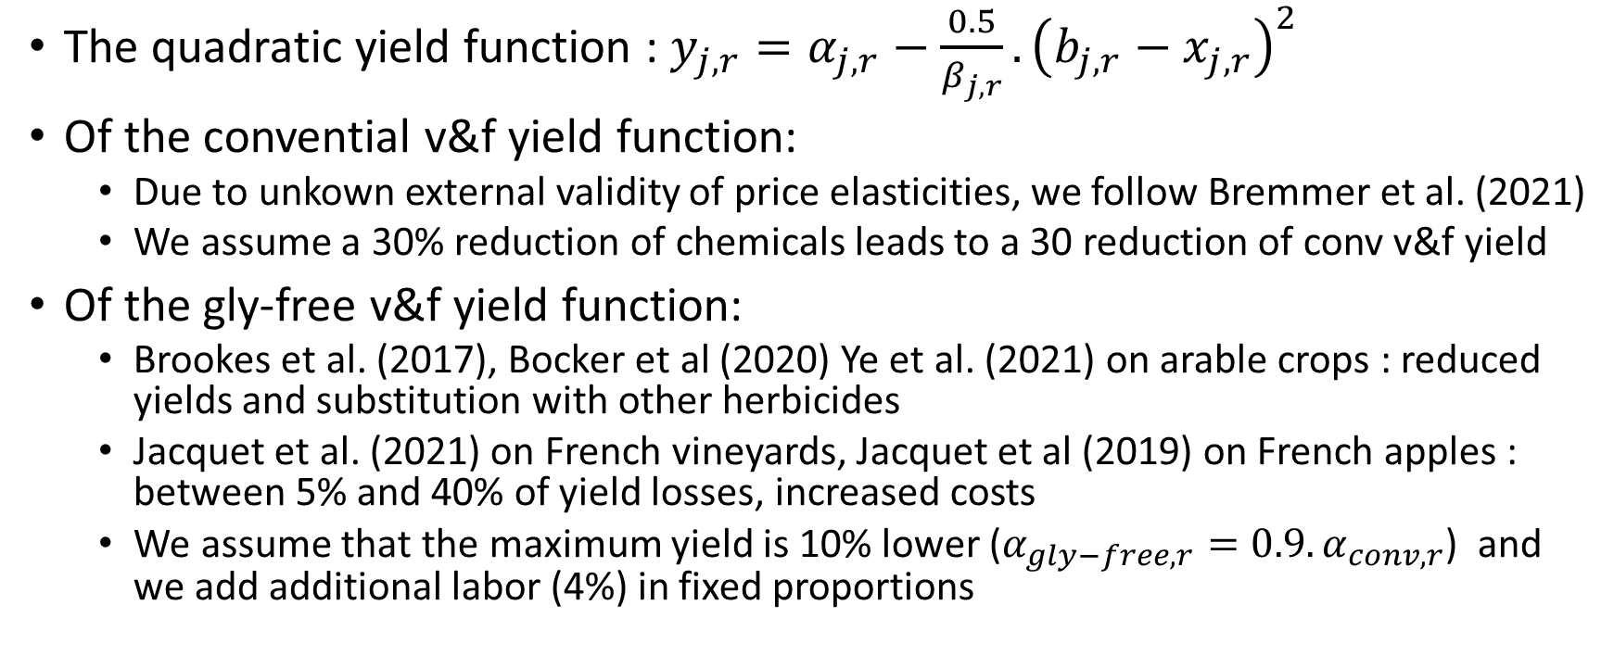
3. Calibration of the supply side
The quadratic yield function : $y_{j,r}=α_{j,r}−\frac{0.5}{β_{j,r}}.{\left(b_{j,r}−x_{j,r}\right)}^{2}$
Of the convential v&f yield function:
  Due to unkown external validity of price elasticities, we follow Bremmer et al. (2021)
  We assume a 30% reduction of chemicals leads to a 30 reduction of conv v&f yield
Of the gly-free v&f yield function:
  Brookes et al. (2017), Bocker et al (2020) Ye et al. (2021) on arable crops : reduced yields and substitution with other herbicides
  Jacquet et al. (2021) on French vineyards, Jacquet et al (2019) on French apples : between 5% and 40% of yield losses, increased costs
  We assume that the maximum yield is 10% lower ($α_{gly−free,r}=0.9.α_{conv,r}$) and we add additional labor (4%) in fixed proportions

Slide 14
Latent point

Slide 15
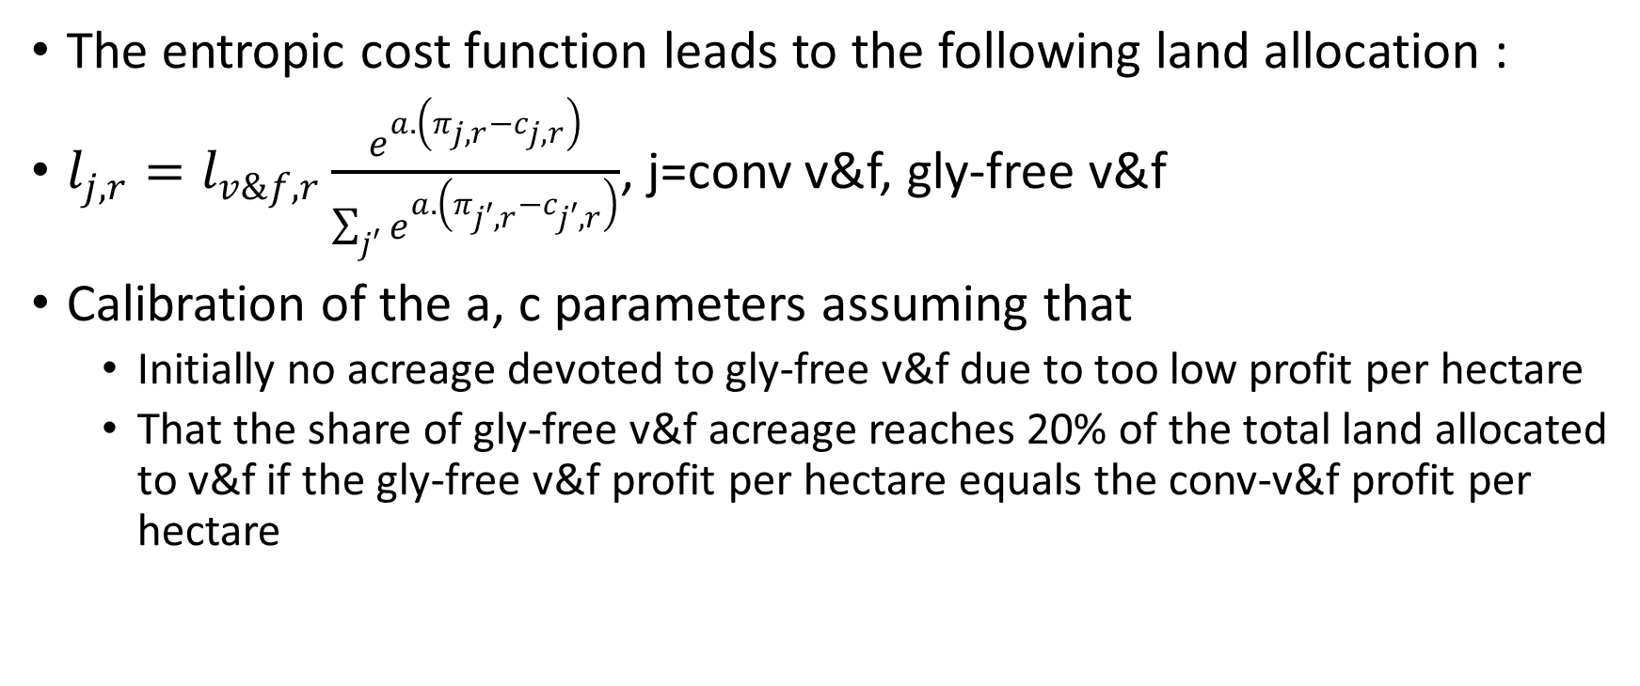
4. Calibration of the supply side
The entropic cost function leads to the following land allocation :
$l_{j,r}=l_{v\&f,r}\frac{e^{a.\left(π_{j,r}−c_{j,r}\right)}}{\sum_{j′}{e^{a.\left(π_{j′,r}−c_{j′,r}\right)}}}$, j=conv v&f, gly-free v&f
Calibration of the a, c parameters assuming that
  Initially no acreage devoted to gly-free v&f due to too low profit per hectare
  That the share of gly-free v&f acreage reaches 20% of the total land allocated to v&f if the gly-free v&f profit per hectare equals the conv-v&f profit per hectare

Slide 16
share
Latent point
Relative price of gly-free v&f % conv v&f

Slide 17
4. Final demand and trade modelling
Standard approach:
  Nested structure with CES functions for the arbitrage between imported and domestic goods, CES-LES-CDE-AIDADS for the arbitrage between composite goods
  Globally regular and partially flexible in price/income effects
  But it does not allow latent demands
Our approach:
  The NQES for trade and preferences (already implemented for trade by Gohin and Laborde, 2006)
  Globally regular and flexible
  It allows latent demands (virtual prices)
  But intensive in parameters. Some separability assumptions.
  Assumptons of perfect substitution for the trade of gly-free v&f

Slide 18
4. Calibration of the trade side
From Fontagné et al. (2022), Armington substitution elasticity between all sources = 7 for conv v&f.
We replace the CES by the NQES, thus maintaining homotheticy with respect to total demand (possibility to introduce quasi homothetic import demand functions)
Assumption of perfect substitution across sources for gly-free v&f
  Unitary trade costs are equal with those of conv v&f
  We assume that only the EU and USA are able produce/consume gly-free v&f.
  Introduction of NQES to be contemplated with more virtual prices when more countries will be considered

Slide 19
4. Calibration of the final demand
First separability of v&f with other foods and other goods/services (both are aggregated with a Cobb Douglas, not a big empirical issue as price effets on other goods are limited).
Large litterature assessing WTP by consumers for reduced exposure to pesticide (Florax et al., 2005 ; Ali et al., 2021): evidence of price premiums.
To calibrate NQES parameters, we assume :
  Initial virtual prices of gly-free v&f = price of conv v&f excluding VAT.
  We assume cross price elasticities and income elasticities. For the gly-free demand, we adopt the elasticities of the conv v&f and a high substitution elasticity between the two types of v&f (elasticity of conv v&f demand with respect to price of gly-free v&f = 25)

Slide 20
4. Simulation of the EU conv v&f demand function (% of initial consumption)
 |  | Price of Gly-free v&f
 |  | 0.9 | 0.95 | 1 | 1.05 | 1.10
Price of the conv v&f | 0.9 | 100.3 | 106.5 | 106.5 | 106.5 | 106.5
 | 0.95 | 0 | 100.1 | 103.3 | 103.3 | 103.3
 | 1 | 0 | 0 | 100 | 100 | 100
 | 1.05 | 0 | 0 | 0 | 96.7 | 96.7
 | 1.10 | 0 | 0 | 0 | 0 | 93.5
The latent point The initial point

Slide 21
4. Simulation of the EU gly-free v&f demand function (% of initial consumption of conv v&f)
 |  | Price of Gly-free v&f
 |  | 0.9 | 0.95 | 1 | 1.05 | 1.10
Price of the conv v&f | 0.9 | 6.4 | 0 | 0 | 0 | 0
 | 0.95 | 106.6 | 3.2 | 0 | 0 | 0
 | 1 | 106.6 | 103.2 | 0 | 0 | 0
 | 1.05 | 106.6 | 103.2 | 99.9 | 0 | 0
 | 1.10 | 106.6 | 103.2 | 99.9 | 96.5 | 0
The latent point The initial point

Slide 22
5. Scenarios
1. the Green Deal : an endogenous input tax to reduce chemical use by 35% and banning glyphosate use in Europe; conv v&f can still be consumed and imported
2. the mirror clause : 1 + conv v&f can not be consumed/imported. The European input tax adjusts to cope with the « rebound » effect

Slide 23
Markets impacts of the Green Deal scenario
 | Conv v&f (changes in %) |  |  |  |  | Gly free v&f (% of initial conv v&f)
 | Price | Supply | Exports to EU | Exports to Row | Final Demand | Price | Supply | Final Demand
USA | 1.4 | 3.1 | 97.5 | 1.4 | -0.8 | 9.4
EU | - | -100 | - | -100 | -76.5 | 12.6a | -40.8b | -32.1c
RoW | 0.9 | 2.8 | 102.2 | - | -0.4

Slide 24
Welfare impacts of the Green Deal scenario
 | Chemical use in v&f (%) | Chemical use in farms (%) | v&f income (bi $ and %) | Farm income (bi $ and %) | v&f bill (bi $ and %) | Food bill (bi $ and %)
USA | 3.1 | 0.5 | 2.1 (5.9) | 2.7 (1.8) | 0.2 (0.4) | 0.4 (0+)
EU | -35.2 | -7.1 | -24.6 (-48.6) | -27.6 (-13.1) | 1.6 (2.4) | -0.9 (-0.1)
RoW | 2.6 | 0.9 | 28.7 (3.8) | 33.1 (1.7) | 4.8 (0.8) | 10.0 (0.2)
Total | 1.5 | 0.5

Slide 25
Market impacts of the Mirror Clause Scenario
 | Conv v&f (changes in %) |  |  |  |  | Gly free v&f (% of initial conv v&f)
 | Price | Supply | Exports to EU | Exports to Row | Final Demand | Price | Supply | Final Demand
USA | 8.6 | -46.6 | -100 | -74.6 | -3.1 | 26.1 | -40.5
EU | - | -100 |  | -100 | -100 | 29.3 | -39.9 | -19.9
RoW | 0.6 | 1.5 | -100 |  | -0.3

Slide 26
Welfare impacts of the Mirror Clause scenario
 | Chemical use in v&f (%) | Chemical use in farms (%) | v&f income (bi $ and %) | Farm income (bi $ and %) | v&f bill (bi $ and %) | Food bill (bi $ and %)
USA | 19.6 | 2.4 | 14.7 | 16.4 | 0.8 | 5.5
EU | -35.1 | -7.1 | -23.9 | -26.6 | 2.5 | 9.2
RoW | 1.5 | 0.6 | 17.2 | 21.6 | 3.2 | 8.4
Total | 1.1 | 0.4

Slide 27
5. Discussion
On the methodology with zero : reproducing Beckman
1. the Green Deal : an endogenous input tax to reduce chemical use by 35% and banning glyphosate use in Europe; conv v&f can still be consumed and imported
2. the mirror clause : 1 + input taxes in the US to reduce chemical use + EU prohibitive tariff on RoW exports. conv v&f can not be consumed/imported. The European input tax adjusts to cope with the « rebound » effect

Slide 28
Markets impacts of the Green Deal scenario with GTAP
 | Conv v&f (changes in %) |  |  |  |  | Gly free v&f (% of initial conv v&f)
 | Price | Supply | Exports to EU | Exports to Row | Final Demand | Price | Supply | Final Demand
USA | 0.8 | 2.0 | 61.7 | 0.5 | -0.5
EU | 7.4 | -31.4 | - | -73.2 | -3.1
RoW | 0.6 | 1.7 | 66.6 | - | -0.3

Slide 29
Welfare impacts of the Green Deal scenario with GTAP
 | Chemical use in v&f (%) | Chemical use in farms (%) | v&f income (bi $ and %) | Farm income (bi $ and %) | v&f bill (bi $ and %) | Food bill (bi $ and %)
USA | 2.0 | 0.3 | 1.4 | 1.7 | 0.1 | 0.2
EU | -33.3 | -6.7 | -22.8 | -25.5 | 0.9 | -0.9
RoW | 1.7 | 0.6 | 19.3 | 21.9 | 3.0 | 6.5
Total | 0.7 | 0.2

Slide 30
Market impacts of the Mirror Clause Scenario with GTAP
 | Conv v&f (changes in %) |  |  |  |  | Gly free v&f (% of initial conv v&f)
 | Price | Supply | Exports to EU | Exports to Row | Final Demand | Price | Supply | Final Demand
USA | 11.1 | -32.9 | 432.9 | -95.2 | -4.3
EU | 69.7 | -28.7 |  | -100 | -37.0
RoW | 0.7 | 2.2 | -100 |  | -0.4

Slide 31
Welfare impacts of the Mirror Clause scenario with GTAP
 | Chemical use in v&f (%) | Chemical use in farms (%) | v&f income (bi $ and %) | Farm income (bi $ and %) | v&f bill (bi $ and %) | Food bill (bi $ and %)
USA | -34.2 | -4.0 | -18.7 | -20.4 | 0.8 | -0.1
EU | -32.8 | -7.2 | -20.2 | -22.4 | -0.2 | 29.1
RoW | 2.2 | 0.7 | 24.4 | 26.1 | 4.3 | 9.7
Total | -0.2 | -0.1

Slide 32
6. Concluding comments
Mirror clauses within the Green Deal : hype or hope ?
Starting from the benchmark GTAP framework, we develop an original model, tailored to the issue of MRL of pesticides within vegetable and fruits products
We simulate ex ante the impacts of glyphosate ban in the EU, allowing EU and USA to implement alternative technologies
As expected, we find that EU farmers may not benefit from mirror clauses if foreign countries are better able to adopt new technologies while households pay higher food bills
We also find that world chemical uses by farmers may not decrease, due to leakage/substitution effects
Our original framework is useful for ex ante, macro-economic assessment of potential regulations on technologies/production/demand/trade flows

Slide 33
WP2 Emerging trade flows
Why do we trade and by how much?
First because there are frontiers (and customs data to analyse)
Many dimensions already analysed/quantified :
  Quality / preferences
  Spatial / transport costs
  Timing of production/consumption / storage costs
  Firm heterogeneity/ scale-network effects
  Stochastic effects
  Policy
The product (and the relevant technology) does not already exist !

Slide 34
Romer P. (1994). New goods, old theory, and the welfare costs of trade restrictions. Journal of Development Economics, 43, 5-38.
The typical economic model implicitly assumes that the set of goods in an economy never changes. As a result, the predicted efficiency loss from a tariff is small, on the order of the square of the tariff rate. If we loosen this assumption and assume that international trade can bring new goods into an economy, the fraction of national income lost when a tariff is imposed can be much larger, as much as two times the tariff rate. Much of this paper is devoted to explaining why this seemingly small change in the assumptions of a model can have such important positive and normative implications. The paper also asks why the implications of new goods have not more extensively been explored, especially given that the basic economic issues were identified 150 years ago. The mathematical difficulty of modeling new goods has no doubt been part of the problem. An equally, if not more important stumbling block has been the deep philosophical resistance that humans feel toward the unavoidable logical consequence of assuming that genuinely new things can happen and could have happened at every date in the past. We are forced to admit that the world as we know it is the result of a long string of chance outcomes.

