Slide 1


Oil palm production by smallholders in Mexico: a sector in danger.
Eric Penot, UMR Innovation, Univ. Montpellier, Cirad, INRAE, Institut Agro, France;
Claudia Monzón Alvarado, Conacyt - El Colegio de la Frontera Sur, Departamento de Ciencias de la Sustentabilidad, Campeche, México
Oscar Hernandez Jimenez,
Axel Labeyrie. CIRAD, UMR Eco&sols.
Laurène Feintrenie, UR Forêts & Sociétés, Catie, Costa-Rica.
December 2022

Slide 2
OiI palm growing areas and study sites: Tabasco and Campeche
Texte
  Texte
    Texte
      texte
        texte

Slide 3
Characteristics of the 2 areas
area | Tabasco | Campeche
quality of soil | rich and deep | average
rainfall | 1800 | 1150
OP yield in t/ha | 20 to 30 t/ha | 1 to 12 t/ha
farmers organization | Active associations and cooperatives | poorly organized
capital availability for replanting | yes | no
diversification | no | yes (partly)
level of intensification for OP | low | low to medium
RSPO | possibly | no
average FFB price per ton | 3300 | 3000
Texte
  Texte
    Texte
      texte
        texte

Slide 4
Table 2: farm typology
type | nb of farmers | SUB TYPE | criteria 1 OP area in ha | criteria 2 : other activity (crops or off farm) | Type
A | 1 | A1 | 0-5 | no | family
 | 4 | A2 | 0-5 | yes | family
B | 3 | B1 | 5-10 | no | family
 | 0 | B2 | 5-10 | yes | family
C | 2 | C1 | 10-20 | no | family
 | 14 | C2 | 10-20 | yes | family
D |  | D1 | 20-200 | no | family business
 |  | D2 | 20-200 | yes | family business
E |  | E1 | Ø 200 | no | Private Estate
 |  | E2 | Ø 200 | yes | Private Estate

Slide 5
The case of Campeche

Slide 6
Gross margin /ha for oil palm

Slide 7
OP average yield per farm

Slide 8
OP prices and montlhy evolution production for 1 farm

Slide 9
Total net income (farm + off farm)

Slide 10
Cash balance

Slide 11
Potential capital for replantation

Slide 12
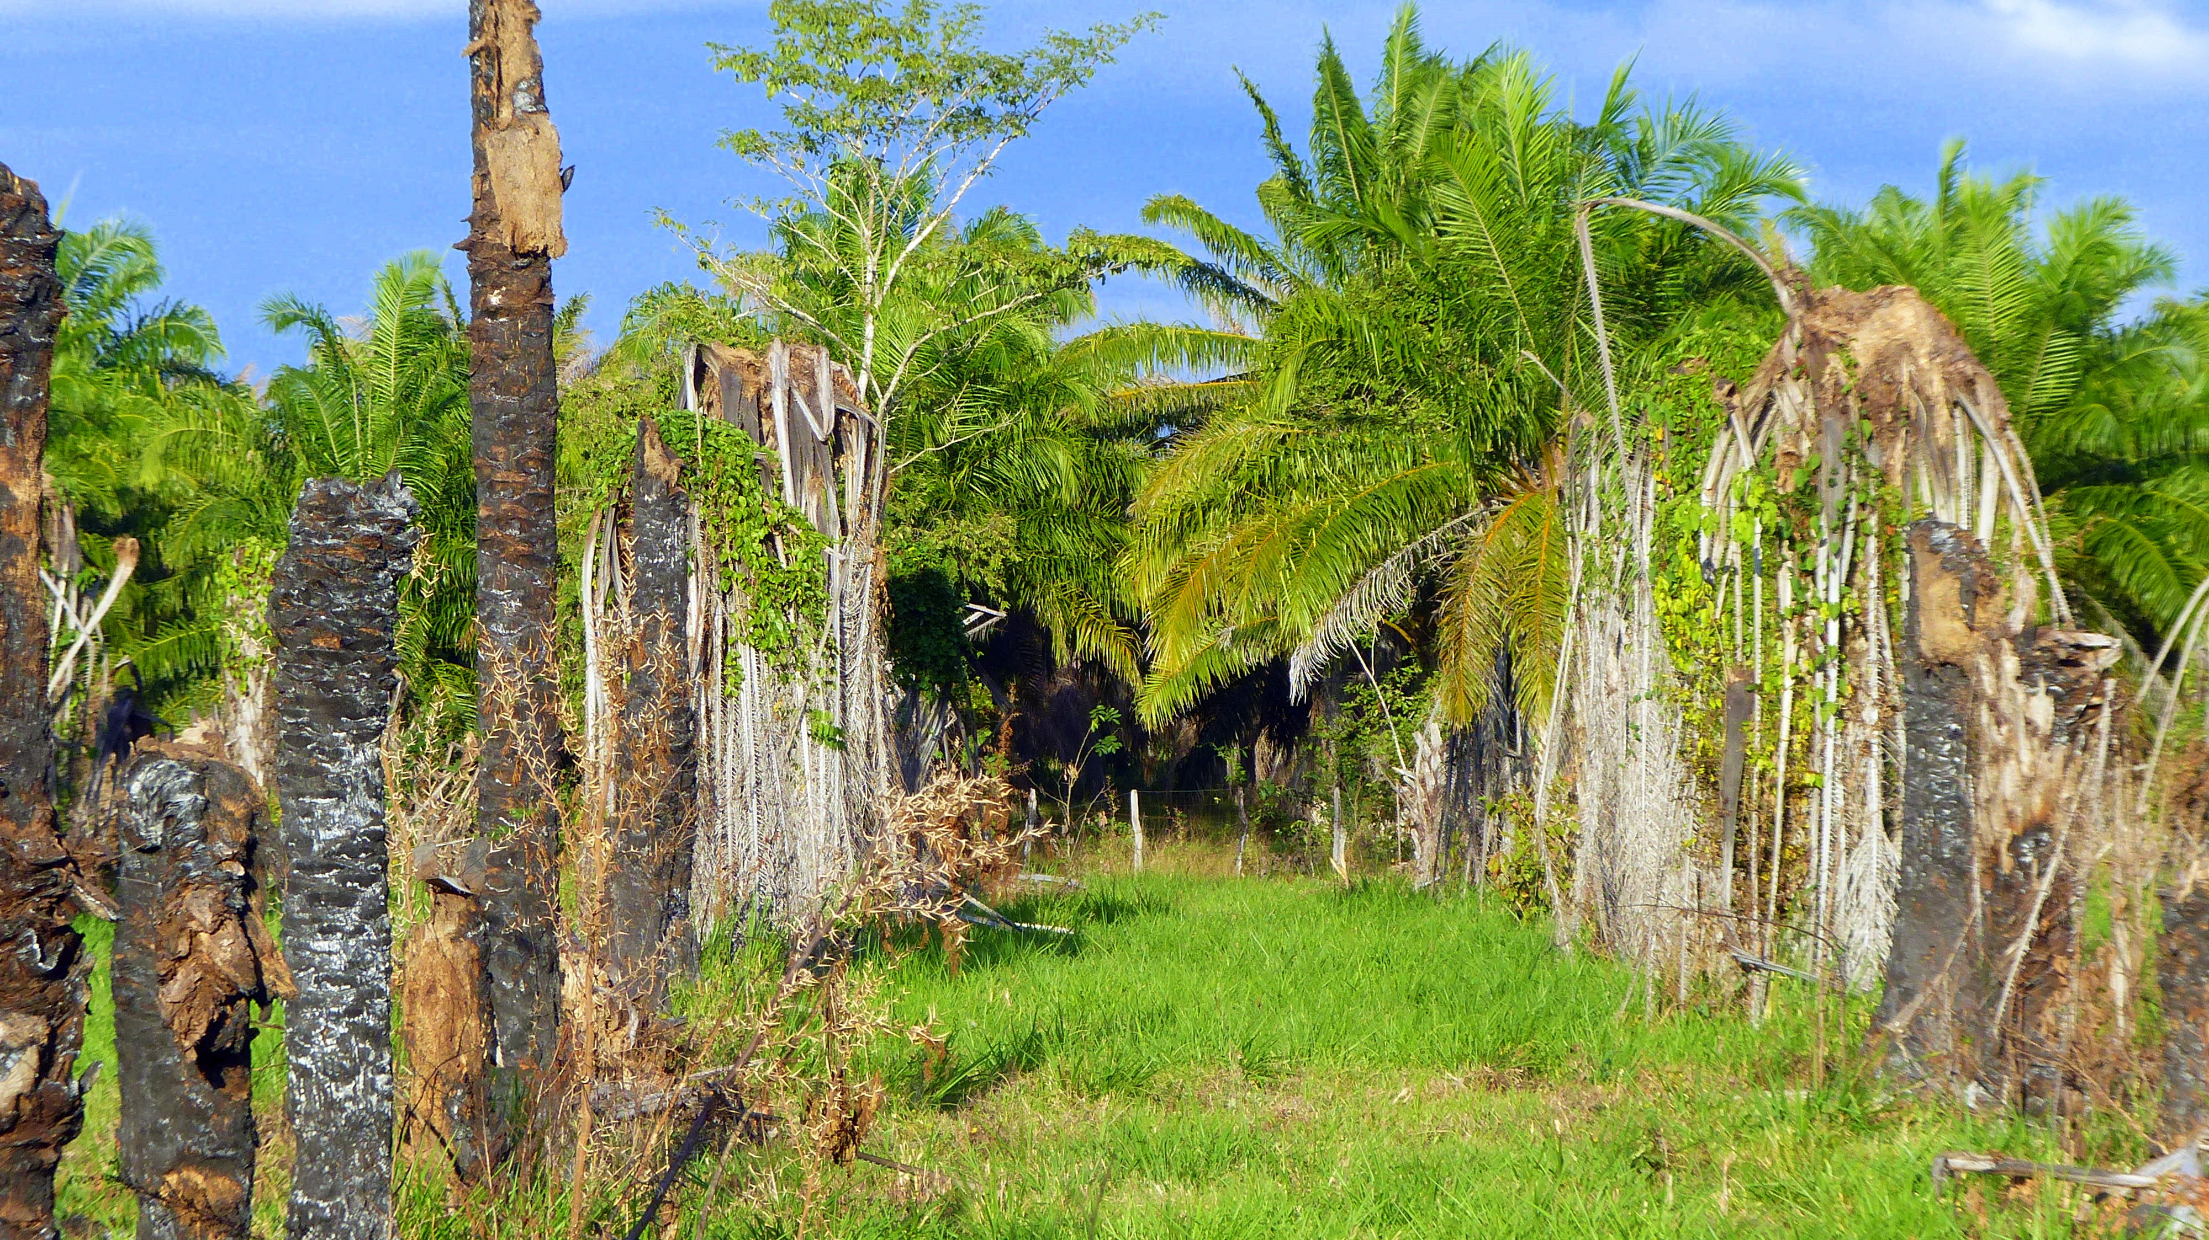
Campêche: old vs new

Slide 13
The case of Tabasco/Teapah

Slide 14
Farm area and OP area

Slide 15
OP average yield per farm

Slide 16
OP Gross margin /ha (plot level)

Slide 17
Total net farm income

Slide 18
Farm cash balance

Slide 19
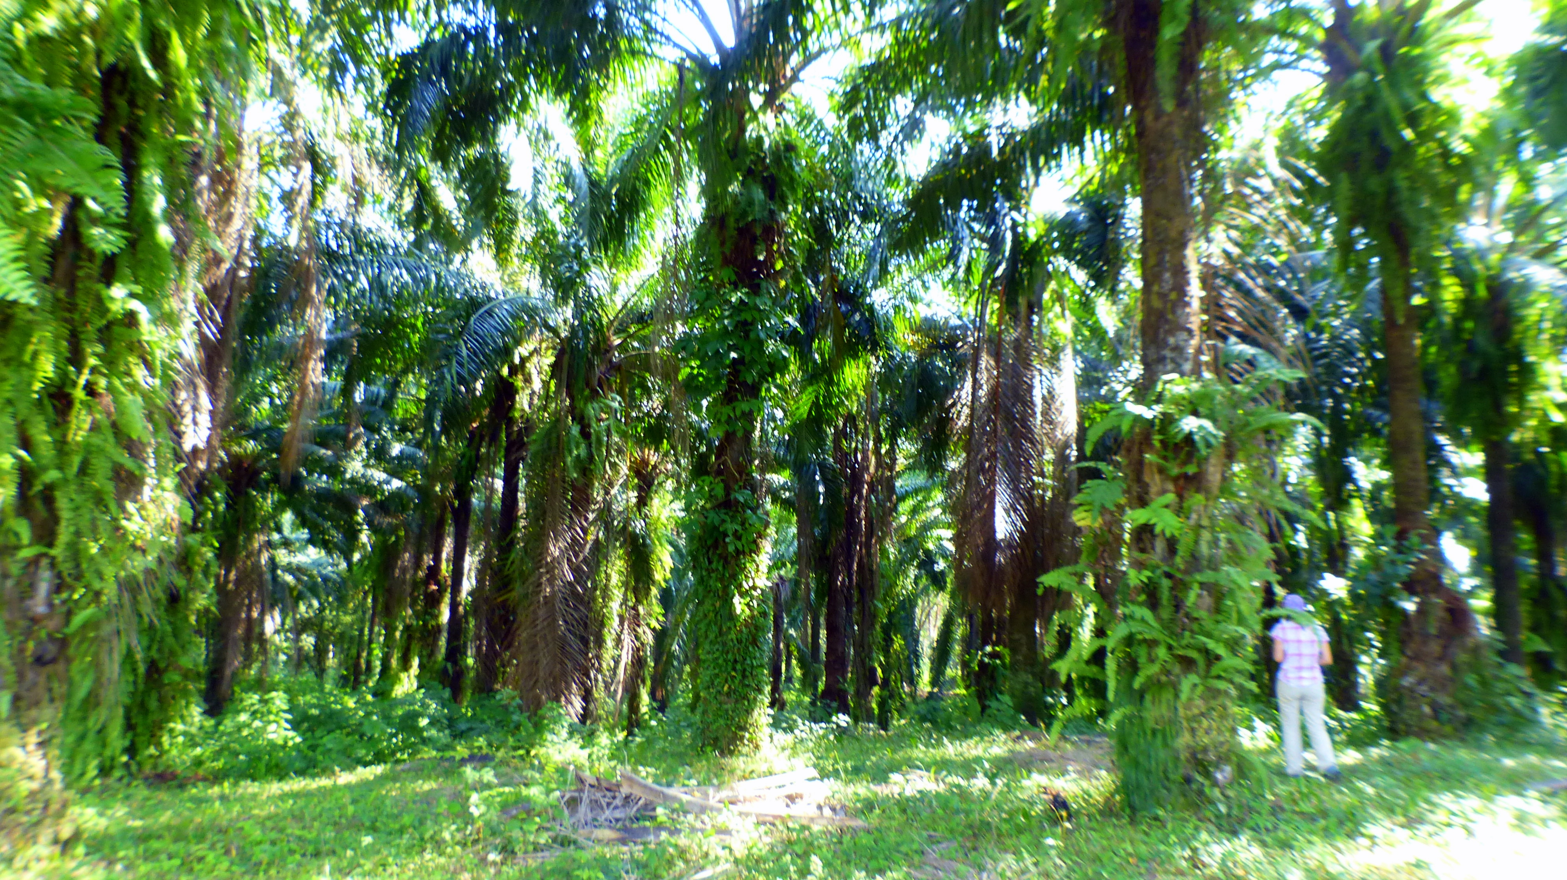
Teapah: 22 years old plot

Slide 20
Conclusion
- poor diversification in the surveyed site in Tabasco (specialization on OP) and some income diversification in Campeche area (livestock/OP/Mais-other annual crops).
- OP yield is directly impacted by soil and climatic conditions as well as fertilization level.
- Farmers organization have a positive impact on transport cost, marketing and access to better price in particular if RSPO certification is obtained (from 2700/3000 to 3600 Pesos per ton so a 20 % increase).
- We clearly see a yield gradient linked with soil and rainfall patterns from Chiapas piedmont (perfect conditions) to Campeche (critical conditions) with intermediate situation in eastern Tabasco.

Slide 21
A gradient of situation
1 the very favorable area of Chiapas piedmont (yield between 20 and 30 tons FFB/ha)
→ High capacity/cash balance for funding replantation
2 the intermediate situation of Tenocique (yield of 8 T/ha and up to 13/14 T/ha for estate)
the area of Campeche (1 to 12 T/ha) with some place considered as marginal for OP.
→ low capacity/cash balance for funding replantation

Slide 22
The challenges
- To improve OP agronomic management with adapted fertilization and weeding patterns in order to optimize yields.
- the necessity to find new alternatives to maintain and diversify their current agricultural income.
The necessity to re-invest in oil palm knowing the fact that most farmers will need help from the government to replant through several possibilities: grants (as in the past), credit with subsidized loans, etc…

Slide 23
conclusion
1 planting techniques
- Lack of knowledge on the origin/variety
of the planting material
Planting material which grows rapidly (difficulty in
harvesting) and which is very sensitive to stress with very
long male flowering periods (peak production and
reduction in yields).
Some producers uses a lot of fertilizer when the trees are
all in a male cycle
lack of advice on techniques: planting material,
fertilization, restitution of organic matter, etc.
Diffcult access to quality inputs/materials.

Slide 24
2 Producers and factories
The distance that separates the producer from the
extraction plant, (often greater than 100 km), → increases the
cost of delivery and lowers the profitability of the oil palm.
The current period is favorable (high price of FFB)
but below a certain price (floor price/breaking point), producers might no longer harvest their tree (not profitable)
poor relations with OP local plants, often in a
monopoly position
OP plants do not participate in the development of the local network
Thus some factories find themselves operating at
under-capacity,

Slide 25
Social impact
→ social gain brought by the oil palm in the 'Ejidos' in terms of
Employment, nurseries, security ….
National interest in developing its palm sector to i) compensate for the
500,000 tons of annual oil imports,
move towards energy autonomy (industry/biodiesel), and
ianticipating future growing demand for fats (food security/climate change).
For this, it would be necessary to at least increase the surface area
by around 100,000 to 200,000 hectares.
The need for government institutions to support its producers
in the next 5 years: 30% of the plantations will have to be renewed
→ Required genetically improved material adapted
The lack of attractiveness of RSPO certification, far too complicated
and dissuasive for small growers.
high labor costs and/or lack of labor to work in the plantations
could be a contraint ,
(useful reconversion) for the current owners of banana plantations.

Slide 26
The future of OP in Mexico ?
OP has a poor image
Priority to the « Sembrano Vida » programme, AFS oriented
OP has some advantages compared to traditionnal livestock systems
OP provides a real significant improvment of farmers incomes in most places
The futur of OP is questionable in some areas in Campeche but
OP remains the best best alternatives in Tenosique and Teapah areas
The question to the goverment : how not no loose the investment
done in the last 20 years on smallholders’ OP sector………

Slide 27
Policy impact
Such situation raised the problem of agricultural policy efficiency
vs crop reputation/environmental issues.
The case of southern Mexico is paradoxal as OP did not raise
deforestation,
is socially and environmentally well accepted by local farmers
and economically efficient when meantime
The government change its policy due to external reputational
factors.
This decision might have severe negative impact on local
agricultural incomes leading to the return to the situation
of being relying mainly on livestock.

Slide 28
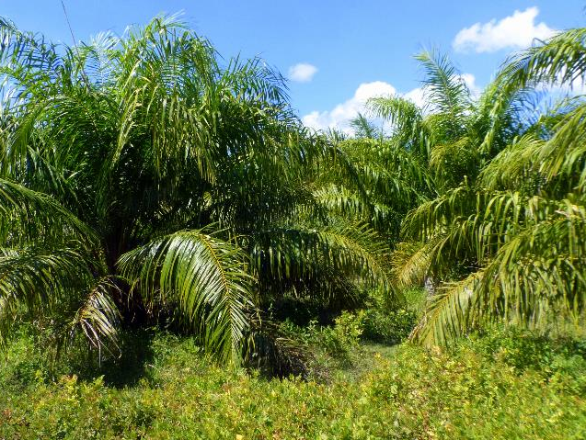
Thanks for your attention
Oil palm Zapata

